Slide 1
Measuring Errors
by
Rashik Rahman
CSE, UAP

Slide 2
Why measure errors?
1) To determine the accuracy of numerical results.
2) To develop stopping criteria for iterative algorithms.

Slide 3
True Error
Defined as the difference between the true value in a calculation and the approximate value found using a numerical method etc.
True Error = True Value – Approximate Value

Slide 4


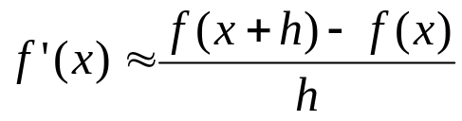



Example—True Error
The derivative,
of a function
can be
approximated by the equation,
If
and
a) Find the approximate value of
b) True value of
c) True error for part (a)

Slide 5
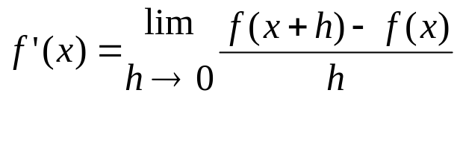


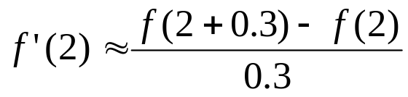
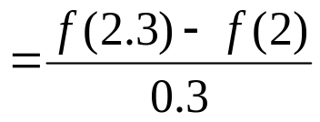
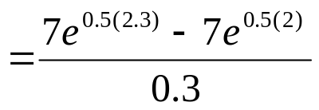
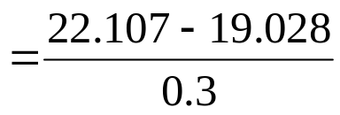

Example (cont.)
Solution:
a) For
and

Slide 6








Example (cont.)
Solution:
b) The exact value of
can be found by using
our knowledge of differential calculus.
So the true value of
is
True error is calculated as
True Value – Approximate Value

Slide 7

Relative True Error
Defined as the ratio between the true error, and the true value.
True Error
Relative True Error (
) =
True Value

Slide 8


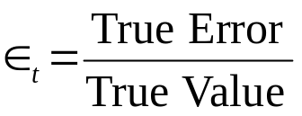
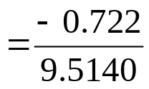



Example—Relative True Error
Following from the previous example for true error,
find the relative true error for
at
with
From the previous example,
Relative True Error is defined as
as a percentage,

Slide 9

Approximate Error
What can be done if true values are not known or are very difficult to obtain?
Approximate error is defined as the difference between the present approximation and the previous approximation.
Approximate Error (
) = Present Approximation – Previous Approximation

Slide 10




Example—Approximate Error
For
at
find the following,
a)
using
b)
using
c) approximate error for the value of
for part b)
Solution:
a) For
and

Slide 11
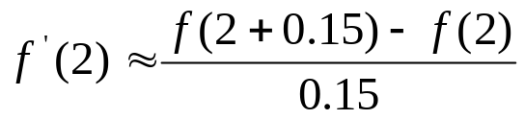
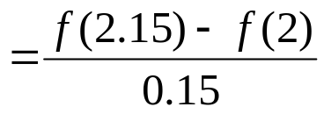
Example (cont.)
Solution: (cont.)
b) For
and

Slide 12
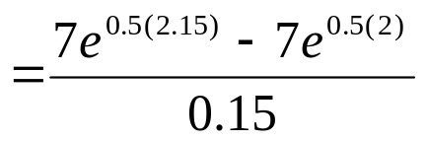
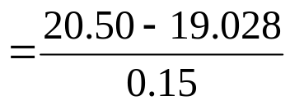




Example (cont.)
Solution: (cont.)
c) So the approximate error,
is
Present Approximation – Previous Approximation

Slide 13

Relative Approximate Error
Defined as the ratio between the approximate error and the present approximation.
Approximate Error
Relative Approximate Error (
) =
Present Approximation

Slide 14



Example—Relative Approximate Error
For
at
, find the relative approximate
error using values from
and
Solution:
From Example 3, the approximate value of
using
and
using
Present Approximation – Previous Approximation

Slide 15

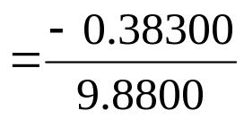



Example (cont.)
Solution: (cont.)
Approximate Error
Present Approximation
as a percentage,
Absolute relative approximate errors may also need to be calculated,

Slide 16



How is Absolute Relative Error used as a stopping criterion?
If
where
is a pre-specified tolerance, then
no further iterations are necessary and the process is stopped.
If at least m significant digits are required to be correct in the final answer, then

Slide 17



Table of Values
For
at
with varying step size,
0.3 | 10.263 | N/A | 0
0.15 | 9.8800 | 3.877% | 1
0.10 | 9.7558 | 1.273% | 1
0.01 | 9.5378 | 2.285% | 1
0.001 | 9.5164 | 0.2249% | 2

Slide 18
Additional Resources
Numerical Methods with Applications: Abridged (2nd Edition) – Autar Kaw, Egwu Kalu
  http://mathforcollege.com/nm/topics/textbook_index.html
Introductory Methods of Numerocal Analysis – S. S. Sastry

Slide 19
THE END

